Slide 1
Alabama Licensing Officials Conference
December 5th, 2024

Slide 2
MVD Org Structure
MVD Admin
  Jonathan Lawrence, Director
  David Baxley, Assistant Director
Registration Admin
  • Trishawn Bell, Motor Carrier Services Supervisor
  • Amanda Fleming, Registration/Warehouse Supervisor
  Jasmine Dill, Inventory

Slide 3
MVD Org Structure
Title Section
  • Lisa Blankenship, Title/Licensing Manager
  • Leslie Mackey, Manager
  Allyson Ward, Customer Service Supervisor
  • Vacant, Examination Supervisor
Audit, Compliance & Inspections Section
  Troy Thigpen, Audit/Compliance & Inspections Manager
  Renee Kyser, Audit Manager
  Maetasha Mitchell, Compliance & Inspections Manager

Slide 4
MVD Org Structure
ALVIN Production Support Team
  • Kristie Pratt, Project Manager
  • Anita Craig, Registration SME
  • Erin McLain, Title/Licensing SME

Slide 5
Contact Us
Admin Phone Line
  334-242-9008
  Admin line is used for immediate needs only
All emails are first name.last name@revenue.alabama.gov
  i.e. david.baxley@revenue.alabama.gov

Slide 6
Legislation Updates

Slide 7
Act 2024-38
Allows for the permanent registration of vehicles and trailers owned by rescue squads
Issued by MVD (like volunteer fire department)
Effective: October 1, 2024

Slide 8

Act 2024-346
Replaces the International Disability Access Symbol with the Dynamic Disability Access Symbol
Impacts to placards/decals
Effective: January 1, 2026

Slide 9
Act 2024-190
Defines and requires titling of off-road vehicles, as well as adding licensing requirements of dealers of off-road vehicles
Beginning January 1, 2026 for every off-road vehicle with a year model of 2026 and beyond
  Exempt if more than 10 model years old
Effective: October 1, 2024*

Slide 10
Definition of Off-Road Vehicle
Motorized vehicle 60 inches or less in width, weight of 1,500 pounds or less, 3 or more non-highway tires, single operator or not more than one passenger
Motorized vehicle 80 inches or less in width, weight of 3,500 pounds or less, 4 or more non-highway tires, operator and number of passengers as provided by manufacturer

Slide 11
Exceptions
Electric bicycles
Golf carts
LSVs
Mini-trucks
Vehicles used for military, fire, emergency, or law enforcement purposes
Vehicles used exclusively on airport property
Vehicles used primarily for agricultural purposes
Self-propelled lawnmowers
Snowblowers
Garden or lawn tractors

Slide 12
Registration Updates

Slide 13
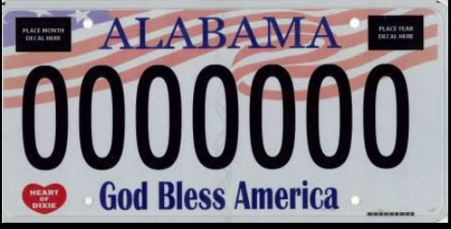
God Bless America Plate
  Legislative Oversight Committee approved reissuance delay for 2 years (2025) due to metal shortage.
  Plate will be reissued in 2025

Slide 14

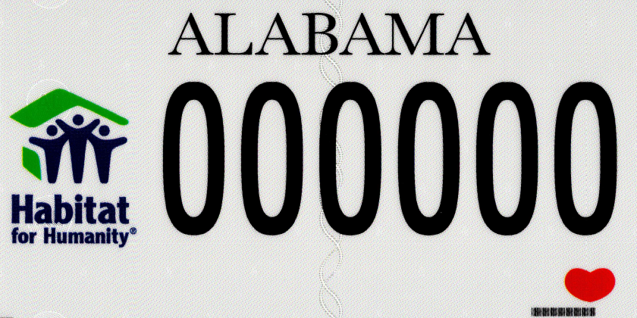

Upcoming Redesigns for March 2025
Helping Schools
Habitat for Humanity
Pink Breast Cancer
Notes:
Put your redesigns here and reference the memo-ones effective jan 1

Slide 15



Upcoming Redesigns for March 2025
Faulkner University
Miles College
University of Alabama
Notes:
Put your redesigns here and reference the memo-ones effective jan 1

Slide 16
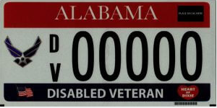
Disabled Veteran License Plate
Design for all disabled veteran categories being retained
All reissued license plates are being moved to the generic numbering scheme, with decal pocket removed.
Notes:
Same do the ones for Jan 1

Slide 17
Disabled Veteran Plates
Disability rating of 10% to 50% (Section 40-12-244)
  First plate is exempt from registration and plate issuance fees NOT exempt from ad valorem taxes.
  All applicable fees are due for subsequent license plates
Disability rating of 51% and higher or vehicle has special mechanical control devices (Section 32-6-130)
  First plate is exempt from registration and plate issuance fees NOT exempt from ad valorem taxes.
  Subsequent license plates have an annual fee of $5.00
Vehicle all or partly paid for by US Dept. of Veteran Affairs (Section 40-12-254)
  All license plates are exempt from registration fees and ad valorem taxes
Not required to obtain DV license plate to claim fee exemptions/reductions

Slide 18
Peeling Tags
Occurred with Plates produced in 2021; resolved with 2022 produced plates and beyond
Any future occurrences report to MVD. Replace plate at no charge (unless registrant changes tag category). Retain damaged plate for audit purposes.
Notes:
Put your redesigns here and reference the memo-ones effective jan 1

Slide 19
Mandatory Liability Insurance
$10.3M in reinstatement fees collected by licensing offices in FY2024
  15% of fees retained by licensing office (32-7A-12)
MLI calls answered by ALDOR taxpayer assistance group (TAG)
Enhancement to allow quick response to MLI notices and auto closing (October 2024)
  Help topic created within the “Help Manager”

Slide 20
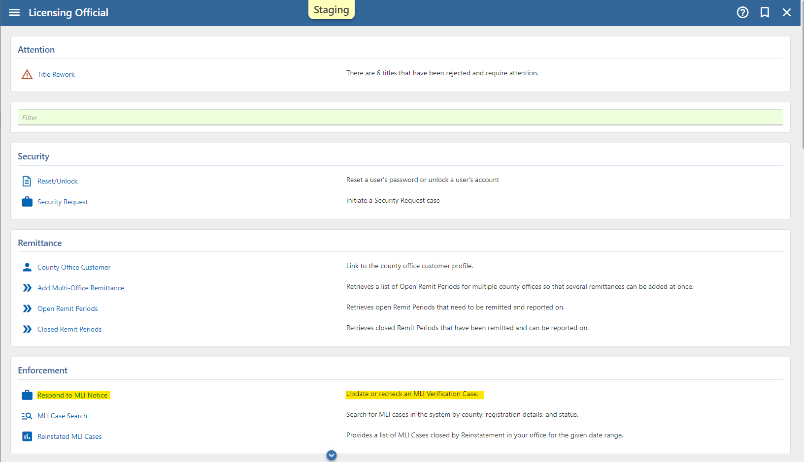
MLI Quick Response

Slide 21
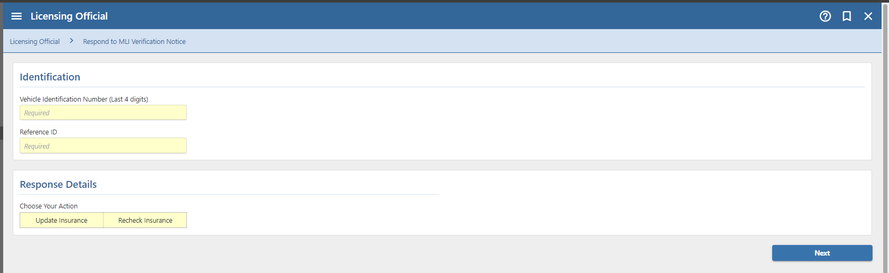
MLI Quick Response
Enter the Last 4 of the VIN and Reference ID from the verification notice to either Update Insurance policy for the verification date or recheck policy on registration record for verification date.

Slide 22
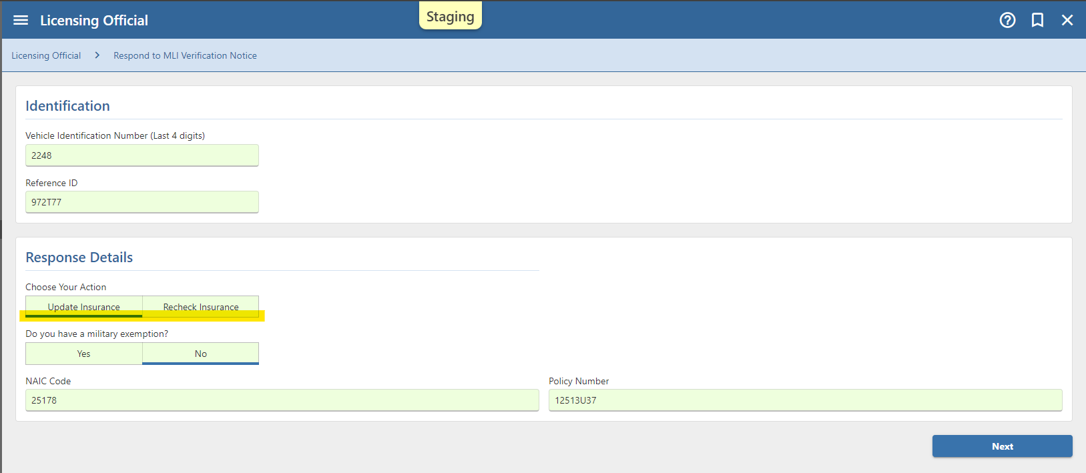
MLI Quick Response

Slide 23
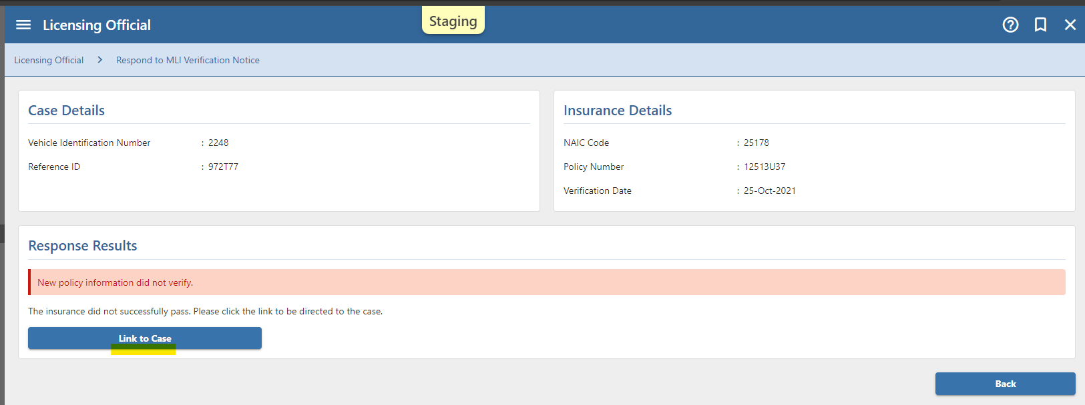
MLI Quick Response
Unconfirmed response – open MLI case to take further action.

Slide 24
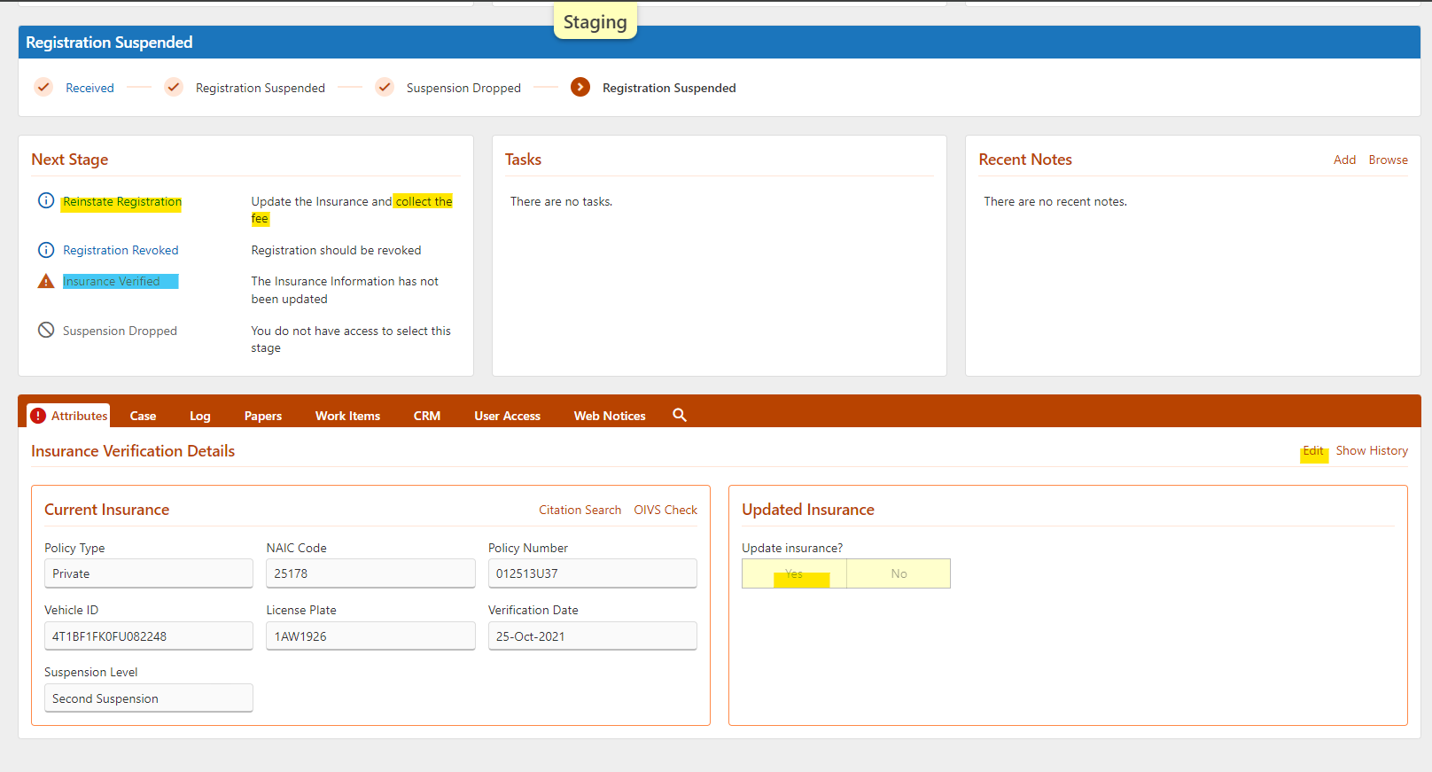
MLI Quick Response

Slide 25
Title/Dealer Licensing Updates

Slide 26
NMVTIS
NMVTIS Webservice
  Validate OOS title information
  Verify liens (when available)
  Check for Brands (i.e. Junk, Salvage, Rebuilt, etc.)
  NICB Stolen Vehicle Check
When titling in ALVIN, the system starts a NMVTIS inquiry as soon as the VIN is entered which allows us to get results in real time.
Used as pre-qualifier in all title related systems
Currently working with AAMVA on a NMVTIS Data Sync
NMVTIS Help Desk
  334-242-9000 Option 5
  NMVTIS@revenue.alabama.gov

Slide 27
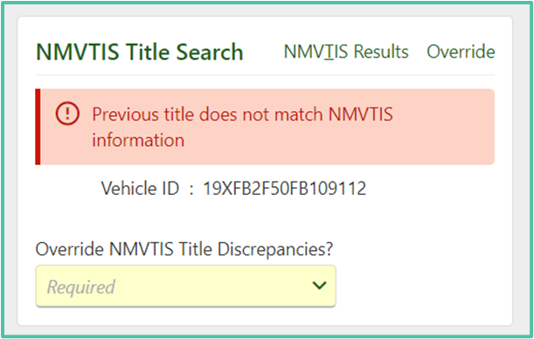
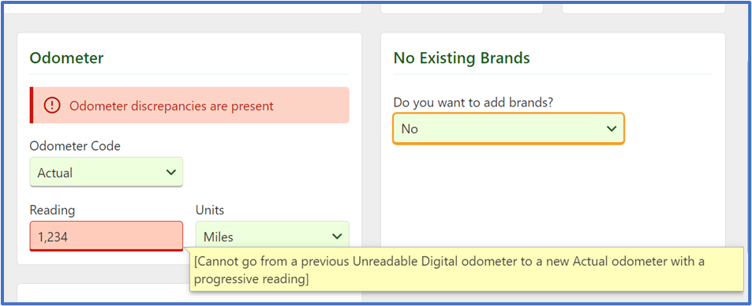
NMVTIS Inquiry Messages

Slide 28
Unclaimed/Abandoned
Deter fraudulent activity
Changes to reporter requirements
  Reporters must upload evidence of NMVTIS inquiry results, records request, and proof of Notice of Possession being sent
Changes to examination process
Increase in rejects
Bonded agents who report vehicles unclaimed/abandoned should process their own applications for title
Notify ALDOR of any suspicious activity

Slide 29
Title Document Upload
Reminders:
Designated Agents are required to upload their title applications electronically for processing.
  Must stamp or write SURRENDERED on the face of the title
Must maintain paper documents for at least six (6) months & electronically for five (5) years
Admin Rule 810-5-75-.42 (Effective January 14, 2022)
Benefits
Eliminates mail processing costs
Eliminates lost paperwork
Eliminates mail processing time

Slide 30
Example of Title Stamped
“SURRENDERED”

Slide 31
Title Document Upload
Document Prep Order does not change
Proper order of scanned documents :
  1st - Signed/dated title app or resubmission document
  2nd - Title document (stamped surrendered) or primary supporting document
  3rd - Supporting documents
Upload daily with normal reconciliation process

Slide 32

Volunteer Fire
Section 40-9-13 of the Code of Alabama exempts a volunteer fire department from the payment of the title application fee required by Section 32-8-6 of the Code of Alabama.
Request fee override

Slide 33
Titling Salvaged Vehicles Issued with Clear AL Title(s)
When will this apply to a vehicle?
  Vehicles with clear Alabama titles that are now being stopped as being salvage.
  All of these will be where a salvage brand exists from another state.

Slide 34
Titling Salvaged Vehicles Issued with Clear AL Title(s)
How to handle?
  Contact MVD about applying for rebuilt inspection
  MVD will determine eligibility for free rebuilt inspection
  If eligible inspection will be completed and MVD would follow-up with LO to complete title app and add Rebuilt Brand
  County Administrator must create the application
  Once application submitted MVD will attach completed Inspection Form and expedite processing of the title application

Slide 35
Manufactured Homes
Manufactured homes designated 1999 and prior year models are exempt from titling.
A fee of five dollars ($5) added for each transaction below to be distributed to the Alabama Housing Foundation.
Each application for certificate of title.
Each application for certificate of title after transfer.
Each application for cancellation of a certificate of origin or certificate of title.

Slide 36
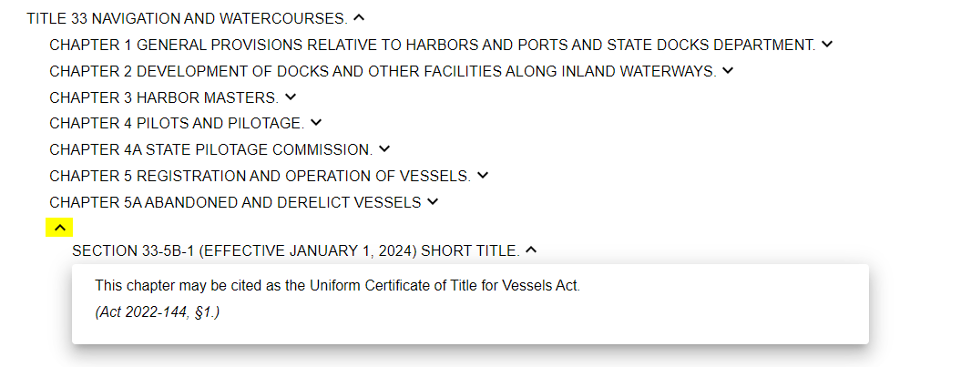
Vessels
Effective: January 1, 2024
ACT 2022-144 codified to the Code of Ala. 1975
Title 33 Chapter 5B:
Uniform Certificate of Title for Vessels Act

Slide 37
Vessels
Application fee $25
$5 local licensing official
$20 general fund
Administrative Rules Amended
Designated Agents- to include boat dealers
Application Guidelines

Slide 38
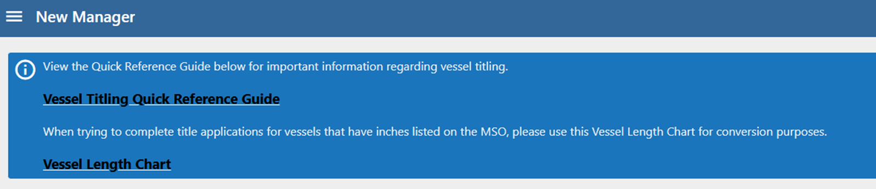
Vessel Resources
ALDOR Website – Motor Vehicle FAQs – Vessel Titles
  Vessels Required to be titled
  Vessels that are Optional for titling
  Vessels exempt from titling
New Manager in ALVIN provides links to the Vessel Titling Quick Reference Guide and Length Chart

Slide 39
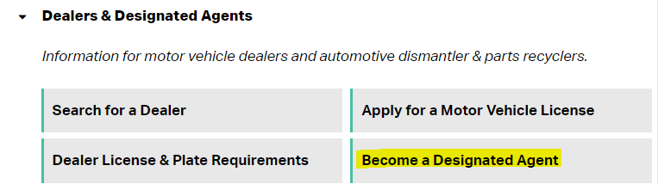
VESSEL DEALERS
Application packet is available on ALDOR-MVD website
  Non-Dealer Application for Designated Agent updated to include Vessel Dealers
  Currently accepting applications
    Ones already received will be processed on December 11, 2023, when we rollout
NOTE: Vessel Dealers are permitted to become a Designated Agent
  ADMIN RULE: 810-5-75-.52 Designated Agent Appointments

Slide 40
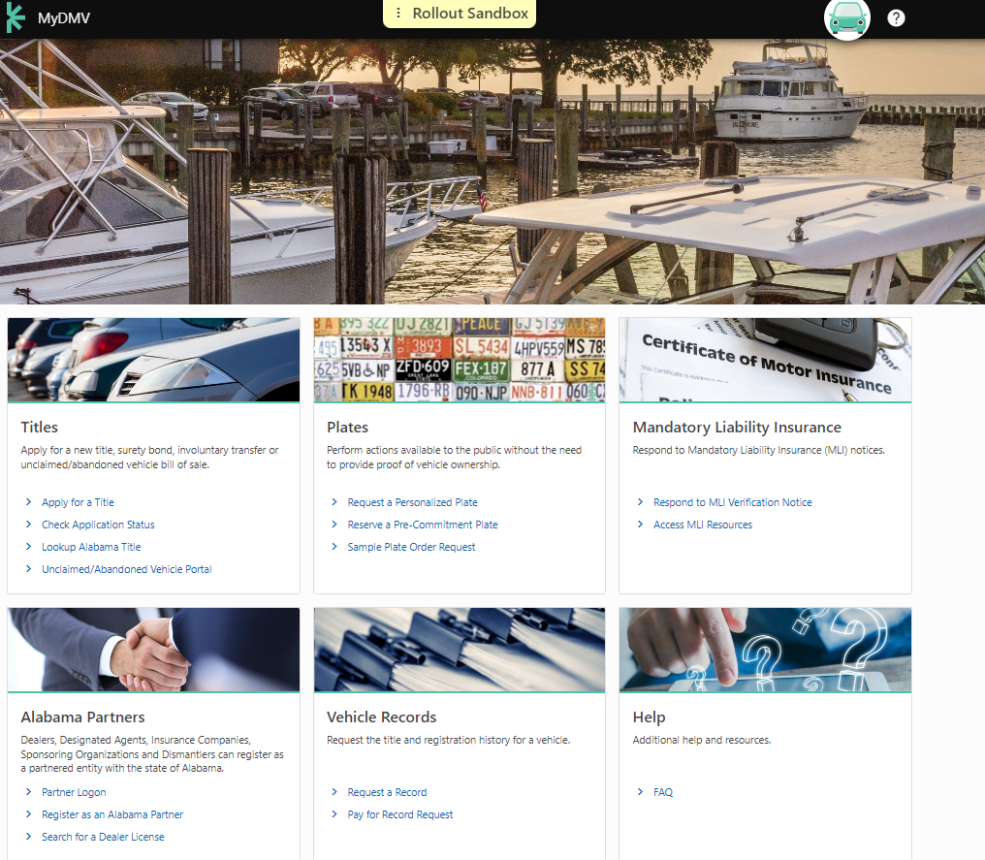
MyDMV

Slide 41
MyDMV
Services
  Dealer Licensing
  Dealer Tags
  Temp Tags
  MLI
  Personalized Tags
  Public Title Applications (Replacements, Lien Release, etc.)
  Records Portal

Slide 42
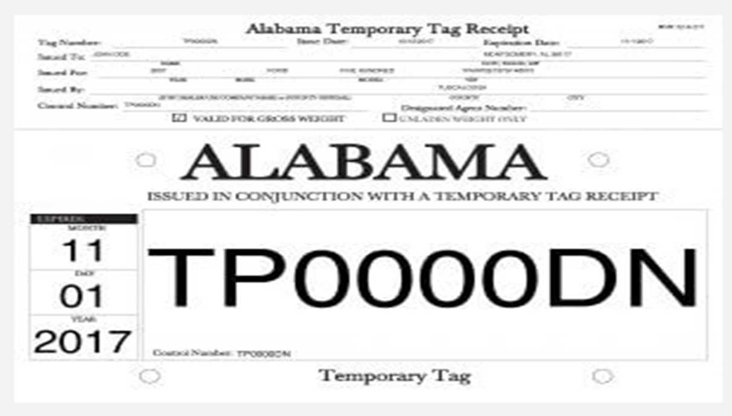
Temp Tags
Dealers Issue 20 Day Temp Tags
County Distribution $.75

Slide 43


Slide 44
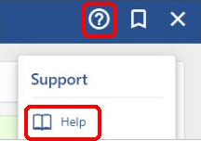
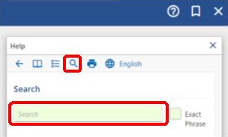
Help Manager
Accessible from any ALVIN window by clicking the icon in the context bar.
Great resource available for assistance
  Includes procedural step-by-step guides that walk you through completing processes in ALVIN
  Provides continuous support

Slide 45
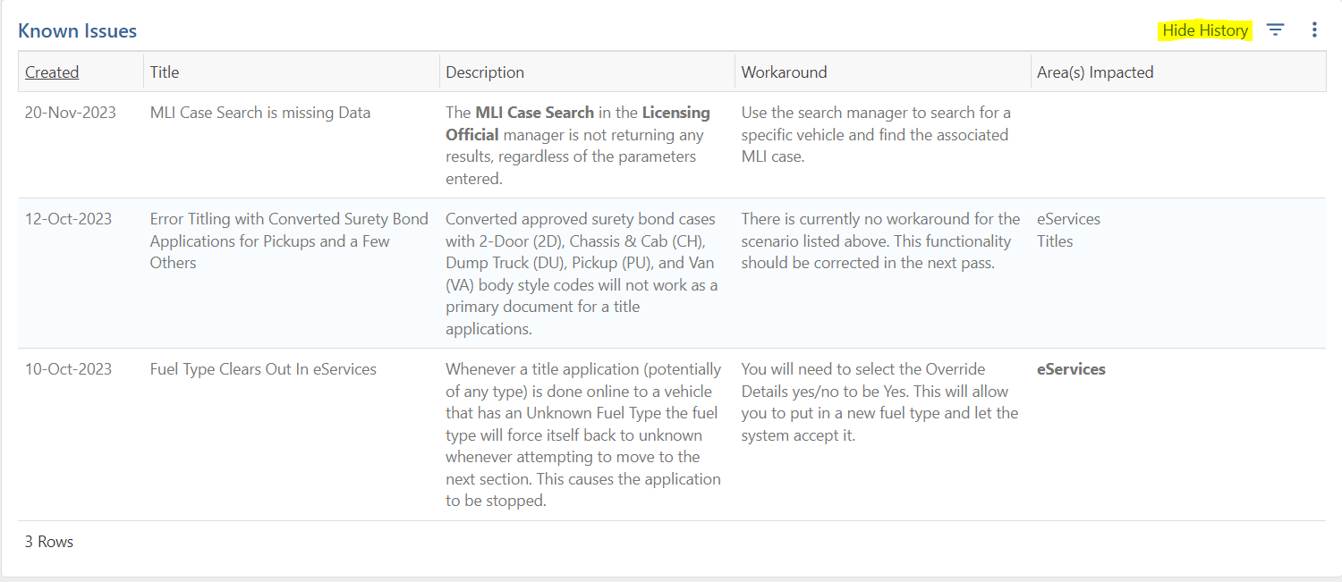
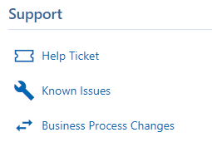
Known Issues Report
  Available in the Licensing Official Manager – Support
    Provides list of current known system issues that have been reported and any workarounds
    As issues are resolved they will appear greyed out

Slide 46
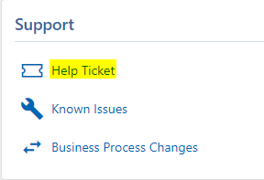
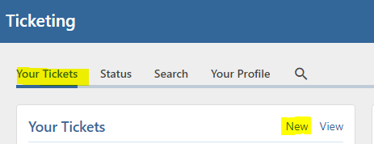
Ticketing
ALVIN will have a feature for licensing officials to submit tickets in ALVIN to report issues or needs in the system.
Tickets are trackable items that notify MVD of anything that may need to be updated/addressed in the system.
Ticket Types
  System Issues
  New/Missing Make Code Request
  General Support
Ticketing is available in the Licensing Official Manager – Support – Help Ticket
NOTE: Only ADMIN users will be able to submit tickets in ALVIN.

Slide 47
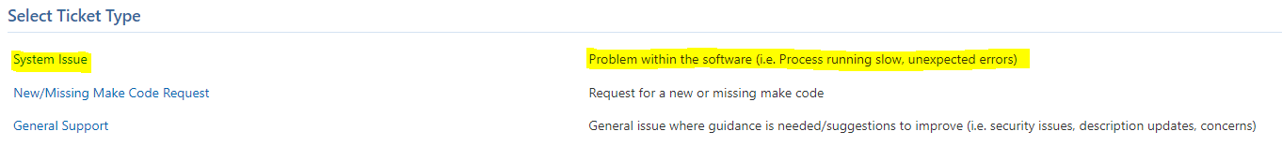
Ticketing – System Issues
Used to report errors when something in the system is not working correctly.
  EXAMPLE – users get an error that doesn’t allow them to complete a transaction

Slide 48
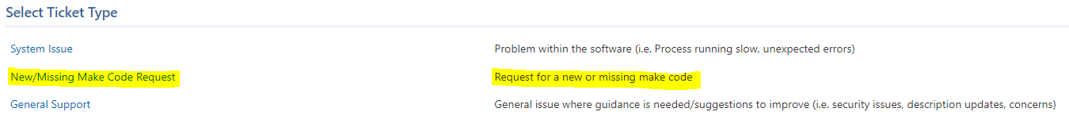
Ticketing –
NEW/MISSING MAKE CODE REQUEST
Used to request additional make codes be added to the system

Slide 49
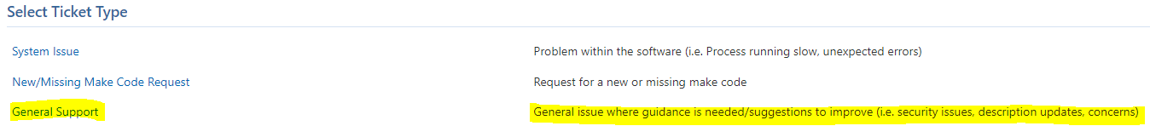
Ticketing – General Support
Used to report any additional issues that come up in ALVIN.
  EXAMPLE – Request a help topic for a specific process

Slide 50
SYSTEM VENDORS UPDATE –
CAPS WEBSERVICE
Effective: January 1, 2025
  CAPS Webservice will no longer be available
All Licensing Officials should reach out to their vendors to prepare for this change when it occurs

Slide 51
Coming Soon!
ALVIN will require two step authentication factor in March 2025
Email will be used initially
Option to change to other methods (SMS, authenticator app, etc.)

Slide 52

Questions

